Slide 1


Slide 2
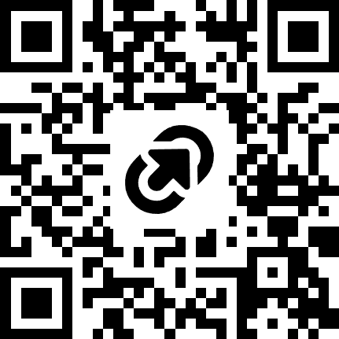
Agenda
Start | End | Topic
9:00 | 9:30 | Intro (Speakers + Audience)
09:30 | 10:15 | Overview of DevOps
10:15 | 11:00 | Pre-requisites + Lab Intros
11:00 | 11:15 | Break
11:15 | 13:00 | Labs
13:00 | 14:00 | Lunch
14:00 | 14:45 | Testing Session
14:45 | 16:30 | Labs (Including testing)
16:30 | 17:00 | Q&A + Wrap Up
https://tinyurl.com/ppdobc2026

Slide 3
Overview

Slide 4
Intro to DevOps
DevOps
Plan
Develop
Build & Release
Test
Operate

Slide 5

Early days of Power Platform DevOps

Slide 6

Current Expectations of Power Platform DevOps

Slide 7
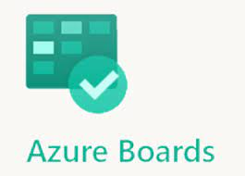
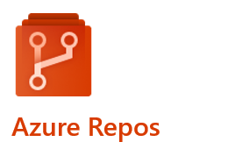
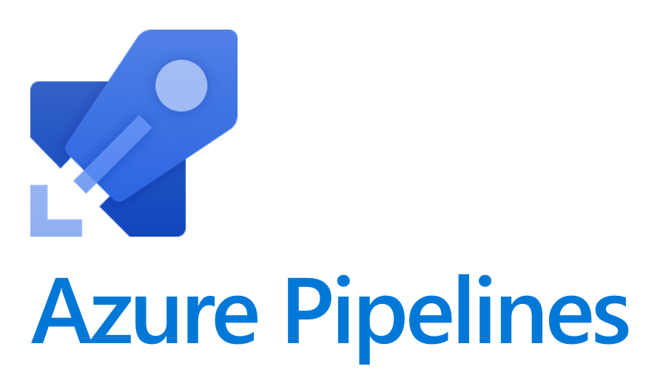
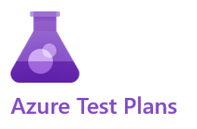

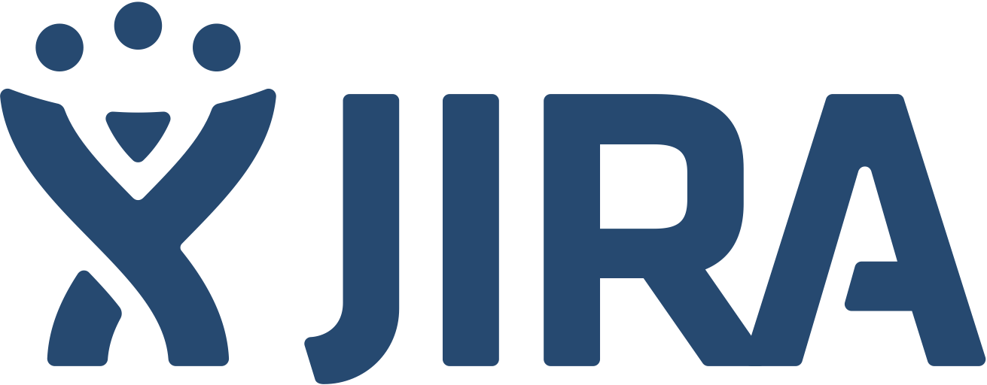

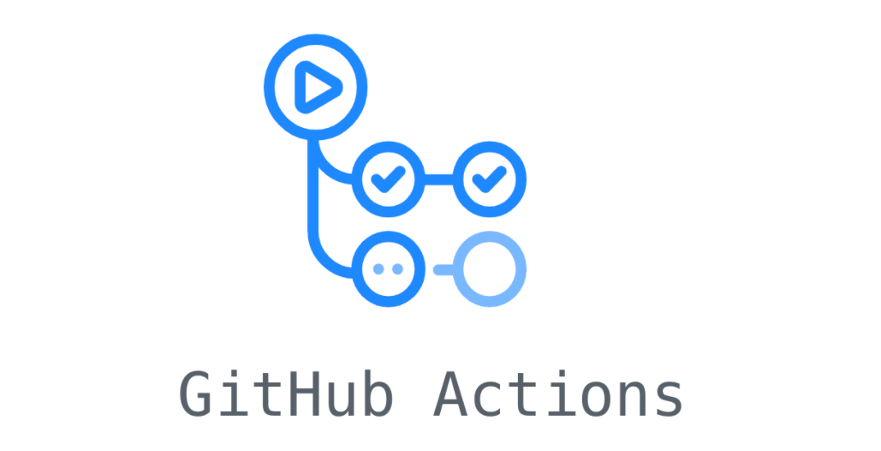

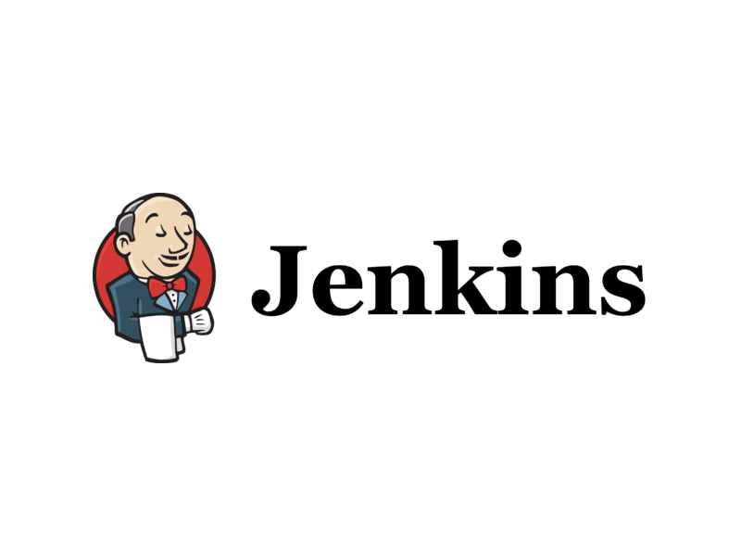


ALM Activities and Tools
Plan
Develop
Build & Release
Test
Operate
Backlog
Prioritisation
Planning
Build components
Source Control
Peer Reviews
Quality Checks
Packaging
Provisioning
Deployment CI/CD
Manual Testing
Automated Testing
UAT
Sign offs
Change Management
Logging & Monitoring
Incidents & Support Administration Feedback
Product Owner Team
Citizen Devs Pro Devs
Pro Devs
DevOps
Testers
Business
DevOps
Operations
Microsoft 365 Health

Slide 8
AI Across the DevOps Lifecycle
⬤ Platform now ⬤ Industry ⬤ Future Potential
📋 Plan
🛠 Build
✔ Test
🚀 Deploy
📊 Monitor & ⚙ Operate
⬤ Copilot in Power Apps — describe an app, get a canvas
⬤ Plan Designer in Power Apps — AI-assisted requirements and app structure
⬤ GitHub Copilot generates user stories from issue descriptions
⬤ Full solution blueprints from a single business prompt
⬤ Vibe coding — App Copilot & App Agent in Power Apps
⬤ GitHub Copilot & Claude Code MCP plugins — Canvas, Code Apps, Power Pages & Dataverse
⬤ GitHub Copilot & Claude Code agentic coding in VS Code
⬤ Autonomous agents scaffold entire solutions from a prompt
⬤ Solution Checker — AI quality & security analysis in the pipeline
⬤ Copilot explains formula errors and suggests fixes
⬤ GitHub Copilot code review agent on every PR
⬤ AI-generated regression suites from solution diffs
⬤ AI component docs & AI release notes in Pipelines
⬤ Preflight conflict & dependency detection
⬤ GitHub Copilot PR summaries & AI deployment risk scoring
⬤ AI recommends deployment windows, auto-reverses failures
⬤ PP Monitor alerts (GA 2026) — proactive alerting for apps, agents & flows
⬤ Copilot in model-driven apps — users query data in natural language
⬤ AIOps — AI-correlated incidents, self-healing infrastructure
⬤ AI suggests optimisations from usage telemetry

Slide 9
Lab 1

Slide 10
Environments
An Environment is a dedicated space in the Power Platform where you store, manage, and run apps, flows, agents and data. Each environment has its own Dataverse database, security boundary, and set of resources — completely isolated from other environments in your tenant.
Environment Types
Production
Live environment for end users. Full Dataverse capacity. Requires a paid licence. Intended for business-critical applications only.
How Environments Fit Into the ALM Pipeline
DEV
Development Environment — Developer type
Where makers build. Unmanaged solutions live here. Changes are exported by the pipeline and committed to source control. One per developer.
Sandbox
Non-production environment used for testing, QA, and UAT. Can be reset and copied. Ideal for Test and UAT stages in the ALM pipeline.
TEST
Test Environment — Sandbox type
Receives managed solution deployments from the pipeline. Used for automated testing and quality checks. No direct customisation.
Developer
Free personal environment for a single developer. Full Dataverse and premium connectors. Used as the DEV environment in this bootcamp.
UAT
UAT Environment — Sandbox type
Business sign-off environment. Stakeholders validate the solution before production release. Gated approval required to progress.
Trial
30-day temporary environment for evaluating Power Platform. Automatically expires. Not suitable for ALM pipelines.
PROD
Production Environment — Production type
Live environment for end users. Only receives managed solutions deployed by the approved pipeline. No direct edits permitted.
Default
Shared tenant environment created automatically. Cannot be deleted. Avoid using in ALM pipelines — no isolation or control.

Slide 11
Solutions
A Solution is a container that groups Power Platform components — apps, agents, flows, tables, and more — so they can be managed, versioned, and moved between environments as a single unit.
What’s Inside a Solution?
Canvas & Model-driven Apps
The apps your users interact with
Think of it as a way of organizing for your related Power Platform work in your development environment.
Dataverse Tables & Columns
Your data schema and structure
Cloud Flows & Automations
Power Automate workflows
Think of it as a shipping container for your Power Platform work — pack it up, move it, unpack it anywhere.
Copilot Studio Agents
AI Agents and Chatbots
Unmanaged · DEV only · editable
Managed · TEST / PROD · locked
Power Pages Sites
External-facing web portals
Connection References
Portable connector definitions
Solution flows through environments via the pipeline:
DEV
TEST
PROD
Environment Variables
Config values per environment

Slide 12
Managed vs Unmanaged Solutions
Unmanaged
Managed
Typical Environment
Development only
Test, UAT and Production
Customisation
Fully editable — components can be modified directly
Read-only — components are locked against direct edits
Source Control
Exported and committed to Git as unpacked source files
Built and packaged by the pipeline from source control
Deleting the Solution
Removes the container only — components remain in the environment
Removes the solution AND all its components from the environment
Version Numbering
Must be incremented manually before each export
Version is stamped and tracked by the pipeline on each deployment
Upgrades & Patches
Not applicable — changes are made directly in the environment
Supports full upgrade and patch deployment via the pipeline
Solution Layering
Active layer — customisations sit on top of any managed layers below
Base layer — provides a foundation that unmanaged layers can extend
Production Use
Not suitable for production — intended for development use only
Designed for production — the correct deployment target for live environments

Slide 13
Solution Segmentation & Design
How you structure and split your solutions affects deployment risk, team collaboration, and solution layering in every environment. Plan this before you build — it is much harder to change later.
📋 Solution Strategies — Simple to Complex
🌍 Environment Strategy for Multiple Solutions
Single solution — all customisations in one solution, deployed as one managed artifact. Simplest to manage but harder to split later if the project grows
Multiple solutions (layered) — a base solution with shared components (tables, security roles) and separate app solutions layered on top. Target environments receive both in order, creating clean managed layers
Isolated solution per team — each solution developed in its own DEV environment. The base managed solution is installed into each team’s environment as a dependency. Best for large enterprise or strict CI/CD scenarios
At minimum: one DEV, one TEST, one PROD. Microsoft recommends at least one separate test environment for end-to-end validation
When developing more than one solution: each solution needs its own isolated DEV environment. Shared DEV environments cause unintended changes to cross solution boundaries and create merge conflicts
Developer isolation: each developer ideally has their own DEV environment with only the required unmanaged solution installed — all dependencies arrive as managed
📂 Table Segmentation — Only Ship What Changed
✅ Best Practices
When adding an existing table to a solution, choose Edit objects and select only the columns, forms, or views that were actually changed — not the entire table
Include all objects only when adding a brand new table that does not yet exist in any target environment — for anything already deployed, select only changed objects
Including unchanged components creates unnecessary solution layers and can shadow or deactivate existing customisations already present in the target environment
Power Platform now auto-detects managed tables and pre-selects only the components with unmanaged customisations, helping prevent bad segmentation
• Use the same publisher across all solutions in a project to ensure consistent schema prefixes and avoid publisher conflicts at import time
• Keep the number of solutions as small as possible — every additional solution adds layering complexity; only split when there is a clear deployment or team reason to do so
• Avoid cross-solution dependencies where possible — they make removal or reordering of solutions difficult and can block uninstall in target environments
• Plan your environment and solution strategy before you build — changing solution structure after deployment to downstream environments is significantly harder
• Never work in the Default Solution — components added there cannot be cleanly packaged, deployed, or version-controlled

Slide 14
Power Platform CLI (PAC CLI)
PAC CLI is a cross-platform command-line tool for automating and scripting Power Platform administration, ALM, and development tasks. It is the foundation for the Azure DevOps Build Tools and GitHub Actions pipelines, and can also be used locally for day-to-day developer workflows.
Three Ways to Install
VS Code Extension
.NET Tool (Recommended)
Windows MSI
Search: Power Platform Tools in VS Code Extensions
Windows, macOS, Linux. PAC only available inside a VS Code terminal unless extra steps taken.
Best for: developers working primarily in VS Code
Command: dotnet tool install --global Microsoft.PowerApps.CLI.Tool
Windows, macOS, Linux. Available in any PowerShell, CMD, or Bash terminal. Does not include pac data or certain pac package commands.
Best for: pipelines, scripting, and cross-platform use
Download: powerapps-cli-1.0.msi from NuGet (Microsoft.PowerApps.CLI)
Windows only. Full feature set including pac data and pac package commands. Includes .NET Framework dependencies.
Best for: Windows-only workflows needing full feature parity
Key Command Groups
Authentication & Useful Commands
pac auth Create and manage authentication profiles for one or more tenants
pac solution Export, import, clone, pack, unpack, and check solutions
Authentication
pac env List, select, and manage Power Platform environments
pac admin Create, backup, copy, and manage environments at scale
Most commands require an active auth profile. Use:
pac auth create — connect to a tenant (browser sign-in)
pac auth list — show all saved profiles
pac auth select — switch between saved profiles
pac pcf Initialise, build, and version Power Apps Component Framework controls
pac data Import and export Dataverse reference data (Windows only)
pac package Deploy Package Deployer packages to environments
pac canvas Unpack, pack, and lint canvas app source files
Verify Installation & Get Help
pac — verify install and see version
pac help — list all command groups
pac solution --help — help for any command group
pac org who — confirm which environment you’re connected to

Slide 15
Git Integration with Power Platform
✗ Without Git
✓ With Git
Two Approaches to Git with Power Platform
✘ No history — impossible to see who changed what or when
✘ No rollback — a broken change can’t be easily undone
✘ Teams overwrite each other’s work with no conflict detection
✘ Manual exports — solutions zipped and emailed or shared via file storage
✘ No audit trail for compliance or governance
✘ Deployments are manual, error-prone, and undocumented
✘ No branching — parallel feature development is nearly impossible
✘ Disaster recovery depends on backups
✔ Full history — every change tracked with author, timestamp, and message
✔ Rollback — revert to any previous working state instantly
✔ Parallel development — branches isolate features without conflict
✔ Single source of truth — Git is the authoritative record of what’s deployed
✔ Audit trail — every commit is timestamped, attributable, and searchable
✔ Automated deployments — pipelines trigger on commits, removing manual steps
✔ Code reviews via pull requests before changes reach production
✔ Disaster recovery — the full solution can be rebuilt from source at any time
1 — Integrated Git (Native)
Built directly into the Power Platform Solutions experience. Makers commit and sync changes to an Azure DevOps Git repository from within Power Apps, Copilot Studio, Power Automate, or Power Pages — no command line required.
Best for: Citizen developers and makers who need version control without learning Git tooling
Requires: Managed Environments • Azure DevOps subscription • DEV environments only
2 — Pipelines + PAC CLI (Pro Code)
Azure DevOps pipelines use PAC CLI tasks to export solutions from DEV, unpack them into source files, commit to Git, then build managed solutions and deploy through TEST and PROD. Source control is the single source of truth.
Best for: Pro developers and teams needing full CI/CD, quality gates, and automated testing
Used in this bootcamp: This is the approach we will be implementing in today’s labs
Both approaches use Azure DevOps Git as the repository. They are complementary — Integrated Git handles the DEV commit workflow; pipelines handle the build and deployment workflow.

Slide 16
Service Principals (SPNs)
A Service Principal (SPN) is a non-interactive, non-human identity registered in Microsoft Entra ID. Pipelines run as this identity rather than as a named user, so deployments never break when someone leaves the team.
Why SPNs Matter for ALM & Pipelines
Setup Overview
• Never breaks when someone leaves — not tied to any individual user account or MFA
• Pipelines run under a consistent, auditable identity across DEV, TEST, and PROD
• Connection references bind to the SPN identity in every environment — no “works on my account” surprises
• Least-privilege access — grant only the roles the pipeline identity needs.
• Access segregation — Different SPNs should be created for non-production environment and production environments.
1
Register App in Microsoft Entra ID Entra ID → App Registrations → New Registration. Note the Application (Client) ID and Tenant ID
2
Add a Client Secret or Certificate Certificates & Secrets tab. Store securely — note the Secret Value immediately (shown once only)
3
Grant Power Platform API Permissions API Permissions → Add → Dynamics CRM → user_impersonation. Grant admin consent
Permissions Required
Entra ID App Registration
• Dynamics CRM — user_impersonation (delegated)
• Admin consent granted by an Entra Global Admin or Privileged Role Admin
Application User in each Dataverse environment
• System Administrator security role (required for solution import/export)
• Must be created in each environment individually (DEV, TEST, PROD)
4
Create Application User in Power Platform
Power Platform Admin Centre → Environments → [Environment] → Settings → Users + permissions → Application users → New app user
Select the registered app, assign a Business Unit, and grant the System Administrator security role. Repeat for every target environment.
5
Create Service Connection in Azure DevOps
Project Settings → Service Connections → New → Power Platform. Provide the Environment URL, Tenant ID, App ID, and Client Secret. Pipeline tasks reference this connection by name.
Authentication methods: Client Secret (password-like, simple to set up, must be rotated) or Certificate (more secure, recommended for production pipelines)
PAC CLI shortcut: pac admin create-service-principal --environment <id> — creates the Entra ID app registration and application user in one command

Slide 17
Lab 1: Export Pipeline
In this lab you will build a pipeline that automatically captures your Power Platform work — exporting both managed and unmanaged solution packages from your DEV environment, converting them to readable source files, and committing it to a feature branch so it can be reviewed and merged like any other code.
Azure DevOps Pipeline — triggered manually or on a schedule, runs on a Windows agent, authenticates as a Service Principal
🧑‍💻
Developer
triggers pipeline
📦
DEV Environment
exported: managed + unmanaged (PackageType: Both)
📂
Unpack
zip → readable source files
📝
Commit to Git
feature branch, not main
🔍
Pull Request
ready for team review
✅
In Source Control
work is safe & reviewable
📤 Why export both?
The pipeline exports both in a single step using PackageType: Both. The solutions are unpacked into source files and committed to Git — these become your source of truth in version control.
📂 Why unpack?
A raw solution export is a single zip file. Git cannot diff a zip — it just sees a binary blob that has changed. Unpacking explodes that zip into individual YAML and XML files, one per component.
Now Git can show exactly which flows, tables, or forms changed — making pull request reviews meaningful.
🌿 Why a feature branch?
Committing directly to main would bypass any review gate and could immediately trigger a deployment. A feature branch keeps the work isolated until it is ready.
A pull request is then raised for a colleague to review the diff before anything progresses toward TEST or PROD.

Slide 18
Lab 2

Slide 19
Connection References
A Connection Reference is a solution component that acts as a named pointer to a connector. Apps and flows bind to the connection reference — not directly to a connection — so the underlying connection can be swapped per environment without changing the solution.
How It Works
Why They Matter for ALM
📱 Flow, Canvas App or Agent
• Decouples flow, app and agents design from specific user credentials and endpoints — connections can be different in each environment without touching the solution
• Flows are turned on automatically after import when a valid connection is provided
• If no connection is provided at import, flows using that reference are automatically deactivated
• Best practice: always use connection references in solution-aware flows, apps and agents
Your solution component
🔗 Connection Reference
Solution component — travels with the solution
When Connection References Are Configured
DEV
PROD
1 During Component Build
Created implicitly when you add a data source to a solution-aware canvas app or flow in DEV
2 Manual Import
You are prompted in the import wizard UI to map or create connections for each reference in the solution
🔑 Connection (dev user)
🔑 Connection (svc account)
📡 Connector (e.g. SharePoint, Dataverse, Teams)
3 OOB Pipelines
The Pipelines deployment screen prompts you to select or map connections before the solution is deployed
4 PAC CLI / Pipelines
Supplied via a deployment settings JSON file passed to pac solution import or the Build Tools Import task
The connection reference travels with the solution. The connection it points to is environment-specific and must be set in each target environment.

Slide 20
Environment Variables
Environment Variables are solution components that store configuration values that differ between environments. They keep environment-specific settings out of the solution itself, making solutions truly portable.
How They Work
Why They Matter for ALM
📋 Environment Variable
SchemaName: cr123_SiteUrl (in solution)
• Keeps environment-specific config out of the solution — no hard-coded URLs, IDs, or secrets baked into flows and apps
• The same solution can be imported into DEV, TEST, and PROD; each environment holds its own current value
• Current values are never exported with the solution — production values are never committed to source control
• Can be referenced in flows, canvas apps, and custom connector definitions
DEV value
https://dev.sharepoint.com/sites/hr
PROD value
https://contoso.sharepoint.com/sites/hr
When Environment Variables Are Set
Supported Types
1 During Component Build
Created and given a default value in DEV when building the solution. Current value left blank for target environments.
2 Manual Import
The import wizard prompts you to enter current values for each environment variable in the solution
• Text — URLs, paths, app IDs, named values
• Number — Thresholds, limits, timeouts
• Boolean — Feature flags, on/off switches
• JSON — Structured config, multiple values in one variable
• Data Source — Points to a SharePoint list, Excel file, or similar
3 OOB Pipelines
The Pipelines deployment screen prompts you to enter values for environment variables before deployment
4 PAC CLI / Pipelines
Values supplied in the deployment settings JSON file passed to pac solution import or the Build Tools task
The variable definition travels with the solution. A default value can be set in the solution; the current value is set per environment and is never exported with the solution.

Slide 21
Deployment Settings
A Deployment Settings file is a JSON file that pre-populates both Connection References and Environment Variables for a target environment, enabling fully automated, non-interactive solution imports in CI/CD pipelines.
Step 1 — Generate the Settings File
Step 3 — Use It in Your Pipeline
Run against an exported solution zip or unpacked solution folder:
pac solution create-settings --solution-zip MySolution.zip --settings-file settings.json
This produces a JSON file with empty values for all connection references and environment variables. Fill in the target environment values before committing to your pipeline.
Option A — PAC CLI (in a script or pipeline task)
Pass the settings file directly to the import command:
pac solution import -p MySolution.zip -s settings.json
The import applies connection references and environment variable values without any interactive prompts. Per-environment settings files are stored as pipeline variables or securely in a variable library.
Step 2 — Populate the File (settings.json)
Option B — Power Platform Build Tools (Azure DevOps)
{
"EnvironmentVariables": [
{
"SchemaName": "cr123_SiteUrl",
"Value": "https://contoso.sharepoint.com"
}
],
"ConnectionReferences": [
{
"LogicalName": "cr123_SharePoint",
"ConnectionId": "a1b2c3d4e5f6...",
"ConnectorId": "/providers/Microsoft.PowerApps/apis/shared_sharepointonline"
}
]
}
In the Import Solution task in the Power Platform Build Tools:
• Enable Use Deployment Settings File
• Set Deployment Settings File to the path of your settings.json in the build artifact
Key Tips
• Store one settings file per target environment (e.g. settings-test.json, settings-prod.json)
• Connection IDs are found in Power Apps under Data > Connections — use the GUID from the connection URL
• Connections must be owned by or shared with the identity running the pipeline
• Do not commit sensitive values (production URLs, secrets) to source control — use pipeline variable groups or Azure Key Vault

Slide 22
Solution Checker
Solution Checker is a static analysis tool that scans every component in a solution — canvas apps, flows, plugins, web resources, and custom connectors — catching problems before they reach production.
Types of Checks
Severity Levels — Design Your Pipeline Gate
⚡ Performance Flows with excessive actions, missing pagination on queries, inefficient data retrieval patterns
🔒 Security Hard-coded credentials, exposed connection strings, insecure HTTP actions without authentication
🛡 Reliability Missing error handling in flows, unsupported customisations that could break after a platform update
🔄 Maintainability Deprecated connectors, legacy APIs, and features scheduled for removal in future platform releases
🎨 Design Canvas apps with too many controls per screen, accessibility violations, overly complex formulas
🔴 Critical 🟠 High → Fail the build. These represent real risk — security vulnerabilities or platform-breaking customisations that must be fixed before the artifact is created
🟡 Medium 🟢 Low ⚪ Info → Report, do not block. Surface in the SARIF report for awareness — teams decide their own threshold over time
🚀 In Your Build Pipeline
The Power Platform Checker task runs after pack, before publish. Think of it as your automated quality gate — no broken solution ever gets packaged as an artifact. Results publish as a SARIF report browsable directly in Azure DevOps alongside test results. Check history is also retained in the maker portal for governance reporting.
Where to Run It
💻 Maker Portal Solutions → Solution Checker → Run. Ad hoc, on demand — good for a quick check during development
🖥 PAC CLI pac solution check — run locally before committing or in a script as part of your workflow
🚀 Azure DevOps Pipeline Power Platform Checker task in Build Tools — runs automatically on every build, fails the pipeline on Critical/High findings, outputs a SARIF report to Azure DevOps test results
🛡 Managed Environments — Enforcement at the Gate
Warn — import is allowed but issues are flagged. Useful for TEST where you want visibility without hard blocking
Block — import is rejected if Critical/High issues exist. Applies to both pipeline imports and manual maker imports — the environment enforces the standard regardless of how someone tries to deploy
Think of pipeline Checker as fail fast and Managed Environments enforcement as defence in depth — two layers, not alternatives.

Slide 23
Lab 2: Build Pipeline
This pipeline runs entirely from source control — no environment is touched. When a PR merges to main, it packs the source files back into a managed solution, validates it, and publishes a deployment-ready artifact.
Azure DevOps Pipeline — triggered automatically on merge to main — no environment connection required
🌿
PR Merged
to main branch
📁
Git Repo
unpacked source files
📦
Pack
source → managed solution
🧪
Solution Checker
quality & security gate
💾
Publish Artifact
managed .zip ready to deploy
🚀
Release Triggered
handoff to Lab 3
📁 Git is the source of truth, not an environment
The build pipeline never connects to a Power Platform environment. The solution is reconstructed entirely from the source files checked into Git — meaning the artifact is reproducible and auditable at any point in history.
📦 The artifact is always managed
TEST and PROD only ever receive managed solutions — this prevents uncontrolled customisations in target environments. Managed solutions enforce your ALM boundary: changes must come through the pipeline, not directly from a maker.
🧪 Solution Checker as a quality gate
Running Solution Checker here — not just as a one-off — means every build is validated for anti-patterns, deprecated APIs, and performance issues before any deployment attempt. Fail the build, fix the issue, never ship broken code to TEST.
💾 Versioning & traceability
Each artifact should carry a version number tied to the build and the Git commit that produced it. This means you can always trace exactly what is running in PROD back to a specific PR, author, and point in time.

Slide 24
Lab 3

Slide 25
Solution Import Types
Update
Upgrade
Replace the existing solution immediately in-place
Stage alongside old version, then cleanly replace
What it does
Overwrites the current version of the solution in the target environment immediately. Components present in the new version are added or updated. Components that are no longer in the solution are NOT removed from the environment.
Key behaviours
• Works whether or not a prior version exists
• Fastest import method
• Deleted components remain — manual cleanup required
• Can enable plug-in steps and flows on import
Use when
• First-time install into a new environment
• Iterating quickly in Test or DEV
• No components have been removed from the solution
• Speed is the priority over clean removal
What it does
Imports the new version alongside the existing solution as a staged upgrade (suffixed _Upgrade). On apply, the old solution and all removed components are deleted from the environment.
Use when
• Deploying to Production or UAT
• Components have been removed and must be deleted from the target
• A controlled, auditable deployment is required
Upgrade (immediate)
Stage for Upgrade
Stages and applies the upgrade in a single import action. Old solution and removed components are deleted automatically on completion.
Best for: standard Production and UAT deployments via the pipeline
Imports the new version but holds both solutions. You manually select Apply Solution Upgrade when ready.
Best for: data migration before cutover, or manual validation before applying
Quick Decision Guide
New environment, fast iteration, or no component removals?
→ Use Update
Production or UAT deployment, or components have been removed?
→ Always use Upgrade (recommended by Microsoft)

Slide 26
Solution Layers
Solutions exist at different layer levels within a Power Platform environment. The topmost layer always wins at runtime.
Working with Layers as a Developer
▲ RUNTIME ACTIVE (top layer wins) ▲
🔍 How to View Solution Layers
Active
Unmanaged Layer
All unmanaged solutions and direct customisations. Single layer. DEV environments only.
1. Go to make.powerapps.com and select Solutions
2. Open your solution and select a component (e.g. a table)
3. On the command bar select Advanced > See solution layers
4. All layers for that component are shown, newest at the top. The Active layer determines runtime behaviour
5. Select a layer to inspect its properties. Use Updated tab for changes only, or All Properties for everything
Last in
Managed Solution (most recently installed)
Can customise any solution installed below it. “Last one wins” for conflicts.
First in
Managed Solution (first installed)
Base managed layer. Restored if the layer above is uninstalled.
Base
System Layer
Platform tables and components. Cannot be removed. Always at the base.
🛠 Use Solution Layers for Troubleshooting
▼ BASE (system foundation) ▼
• Identify which solution introduced a specific change to a component
• Diagnose unexpected component behaviour caused by layering conflicts
• Resolve dependency issues during solution import failures
Key Behaviours
• Last one wins: when two managed solutions conflict, the most recently installed solution’s definition applies at runtime
• Merge logic: for some component types (e.g. forms, ribbons) Dataverse merges changes rather than replacing them
• Uninstall behaviour: removing a managed solution restores the layer below; removing all managed solutions falls back to the system layer
• Avoid component overlap: do not include the same component in more than one unmanaged solution
⚠ Removing an Unmanaged Layer
To remove: open the solution → select the component → See solution layers → select the unmanaged layer → Remove active customizations
• This action cannot be reversed — all data associated with the unmanaged customisation can be lost
• If the unmanaged layer is the only layer, you must delete the component itself instead

Slide 27
Lab 3: Deploy Pipeline
This pipeline takes the artifact produced by the build and deploys it to a target environment — applying environment-specific configuration, passing a human approval gate, and importing the managed solution.
Azure DevOps Release Pipeline — triggered by artifact publication — authenticates as Service Principal — environment-aware
💾
Build Artifact
managed solution .zip
🚦
Approval Gate
human sign-off required
⚙
Apply Settings
conn refs & env variables
📥
Import Solution
managed into target env
🔍
Validate
flows on, components active
✅
Live in TEST
repeat for PROD
🚦 Approval gates protect target environments
A gate pauses the pipeline and requires a named approver to sign off before deployment proceeds. This is especially important for PROD — automation gets the work to the door, a human decides when to open it.
⚙ The same artifact, different configuration
The managed solution is identical for every environment. What changes is the deployment settings file — connection references and environment variables are resolved per target, keeping environment-specific values out of the solution itself.
✅ What a successful deployment looks like
The managed solution appears in the target environment, flows are turned on automatically (because connection references were resolved), and no unmanaged layers exist. The environment is clean, controlled, and matches what is in Git.
📋 The same pipeline promotes through every stage
The same release pipeline runs for TEST, UAT, and PROD — only the deployment settings file and approval gate differ per stage. This means you are deploying and testing the exact same artifact everywhere, not rebuilding per environment.

Slide 28
Azure DevOps Git is the shared repository for both approaches. PRs and merges always happen in Azure DevOps. N = Native (Integrated Git) P = Pro Code (Pipelines + PAC CLI) N+P = Same for both
1 Make Changes
2 Commit to Git
3 PR & Review
4 Build & Package
5 Deploy to TEST
6 Approve & PROD
Build & configure in the DEV environment
N + P Make changes inside Power Apps, Copilot Studio, Power Automate, or Power Pages
Push changes to the Azure DevOps Git repository
N Commit via the Source Control panel in the Solutions area — no CLI needed
P Capture pipeline runs pac solution export + unpack, then commits unpacked source files to Git
Raise a pull request in Azure DevOps for team review
N + P Same for both approaches — PR is raised directly in Azure DevOps Repos, not inside Power Platform
Reviewers inspect the diff of solution source files before approving the merge
Create a managed solution artifact ready for deployment
N Power Platform Pipelines export the managed solution directly from the DEV environment
P Build pipeline packs source from Git, runs Solution Checker, produces a managed artifact
Import the managed solution into TEST for validation
N + P Same outcome for both — managed solution is deployed to TEST via a pipeline or Power Platform Pipelines
Gated approval, then deploy managed solution to PROD
N + P Same outcome — approval gate in the pipeline before the managed solution is promoted to PROD

Slide 29
Additional Info

Slide 30
Build Process
Sources
Customizations
Build
Pack
Artifacts
Solutions
.NET Code (Plug-ins, CRM Packages)
Web Resources
Compile
Minify
Run Static Analysis
Run Unit Tests
Packages
Data
Tests
Custom Controls
Sign
Reference Data
Version

Slide 31
Release Process
Artifacts
Solutions
Release
Approvals
Environments
Test
SIT
UAT
OAT
Packages
Data
Tests
Backup/Rollback
Provision Environments
Import Solutions
Execute Packages
Import Data
Additional Steps
Execute Tests
Pre-Prod
Prod
Dev
PoC
Demo
Training
Notifications

Slide 32
Configuration Migration Tool
The Configuration Migration Tool (CMT) transports configuration data (records stored in Dataverse tables) between environments. It moves data, not metadata — solutions handle table definitions, CMT handles the rows inside them.
✔ Use CMT for
✘ Not for
📄 Schema
schema.xml
📤 Export
data.zip
📥 Import
target environment
• Look-up / reference data (categories, types, codes)
• App configuration records (settings, rules)
• Test / demo seed data
• Table / column definitions → use Solutions
• Large transactional / business data volumes
• File / attachment / binary content
↑ version-controlled in Git
In CLI & Pipelines
Limitations
Best Practices
PAC CLI: Use pac data export and pac data import with --schemaFile and --dataFile flags. Windows only (.NET Framework dependency)
Azure DevOps: Use the Export Data and Import Data tasks in Power Platform Build Tools, or run PAC CLI in a PowerShell script task. Store schema.xml and data.zip as pipeline artifacts
• Not for large data volumes — designed for configuration, not bulk transactional data
• No binary / file content — attachments and notes files are not migrated
• Schema must be maintained — update the .xml file whenever the data model changes
• Order dependency — parent records must exist before child records can import
• Windows only via PAC CLI — requires .NET Framework; use Windows agent in pipelines
• Store schema.xml in Git alongside your solution source files
• Ensure tables and columns exist in the target environment before importing data — deploy solution first
• Define uniqueness conditions in the schema to prevent duplicate records on re-import
• Use Disable plug-ins option during import to avoid unintended side effects
• Use pac tool cmt to launch the GUI tool to build and test the schema before automating

Slide 33
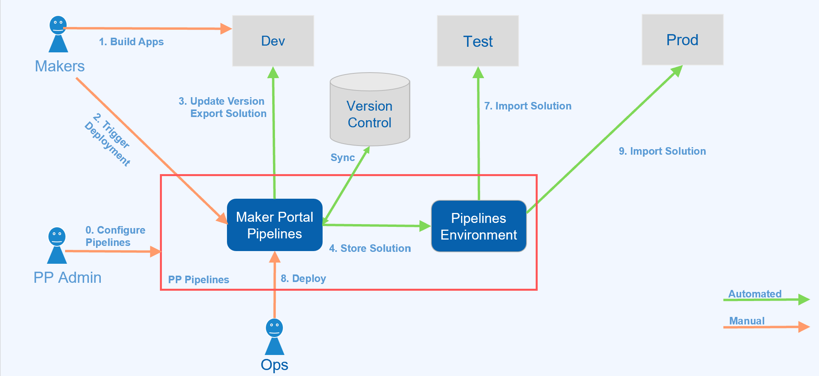
PP Pipelines

Slide 34

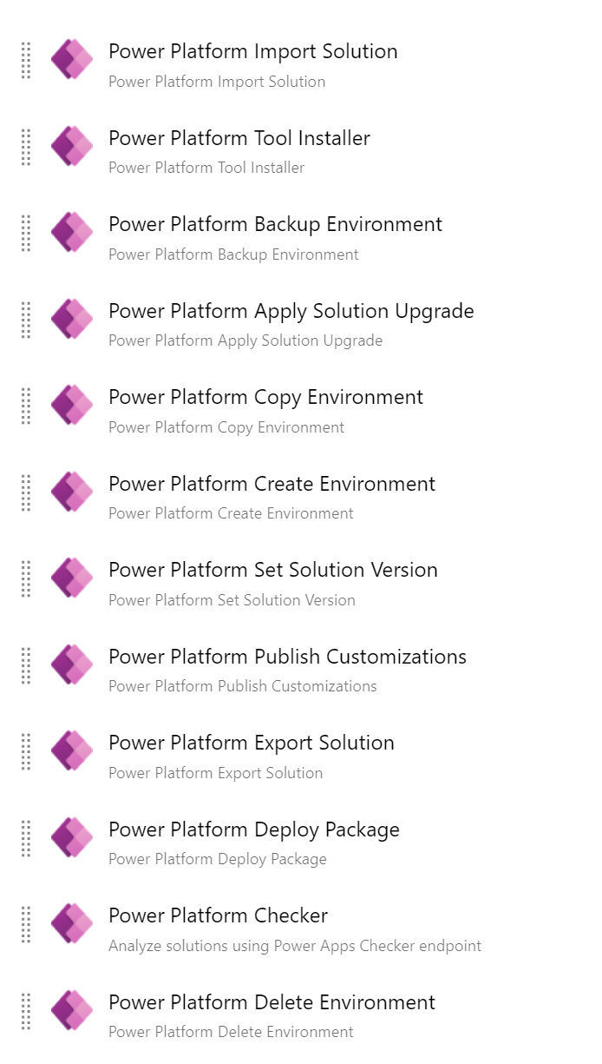
Power Platform Build Tools
Preview Released in July 2019 and Initial Release in June 2020
Supports Dynamics CE/PowerApps
Published by Microsoft
Over 25 Azure DevOps Tasks for
Solution Import/Export/Apply
Solution Pack/Unpack
Package Deployer
Solution Checker
Utilities (Version/Publish)
Environments Management
Power Apps Pages/Data
Notes:
https://marketplace.visualstudio.com/items?itemName=microsoft-IsvExpTools.PowerPlatform-BuildTools

Slide 35
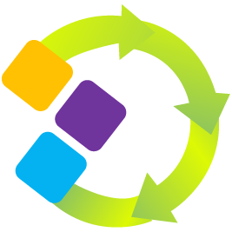
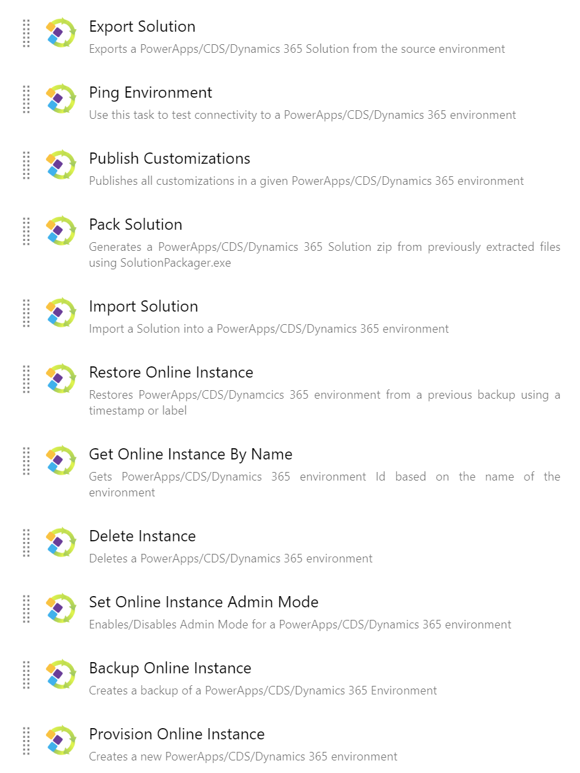
Power DevOps Tools
Released in Jan 2017
Supports 9.x/8.2* (Online/On-premises*)
Free Open Source on GitHub
Over 50 Azure DevOps Tasks for:
Solution Import/Export/Upgrade
Solution Pack/Unpack (Mapping File)
Package Deployer
Solution Checker (Quality Gate)
Environments Management (Get/Admin Mode)
Utilities (Version/Publish/Plug-ins/Web Resources)
Solutions (CRUD/Copy/Clone/Patch/Validate)
Reference Data (CMT) / Configuration Data
Environment Variables/Service Endpoints

Slide 36

Current State of Power Platform DevOps

